Slide 1

By Virupaksh Jadhav
Business Analyst Career Program - Capstone Project

Slide 2

Agenda
Data Exploration
Statistical Analysis using Excel
Graphical Analysis using Excel
Insert the given data into the SQL server
Import the Data from the SQL Database into PowerBI
Interactive Dashboard by using visualization tools
Conclusion and Inferences
Endnotes

Slide 3
Data Exploration
We have collected data on various segments, including
Channel Partners,
Enterprise,
Government,
Midmarket, and
Small Business
for the period covering 2013 and 2014.
The data includes information on several bike products, such as Amarilla, Carretera, Montana, Paseo, Velo, and VTT.
The data is broken down by country, with information available for Canada, France, Germany, Mexico, and the United States of America.

Slide 4
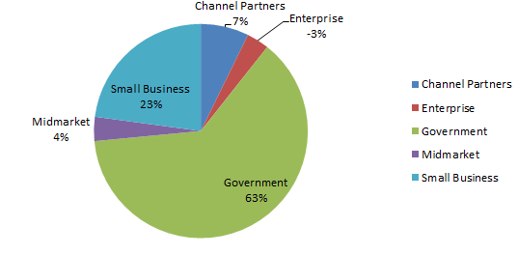
Statistical Analysis using Excel
Profit Per Segment
Channel Partners: experienced a 7.79% increase in profit.
Enterprise: experienced a -3.64% decrease in profit (Lowest)
Government: experienced a significant increase of 67.41% in profit (Highest )
Midmarket: experienced a 3.91% increase in profit.
Small Business: experienced a notable increase of 24.52% in profit

Slide 5
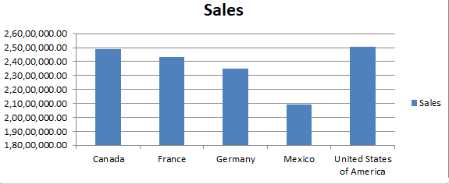
Graphical Analysis using Excel
Country wise Sale
Upon analysis of the sales data, it has been found that there is no significant difference in sales between the countries of Canada, France, Germany, Mexico, and the United States of America. However, it should be noted that Mexico has the lowest sales figures among these countries, while the United States of America boasts the highest sales figures in the bike sector with a total of 25,029,830.165 dollars.

Slide 6
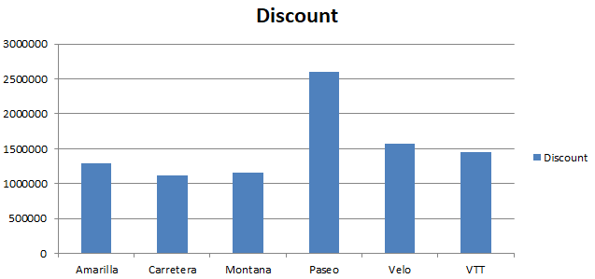
Graphical Analysis using Excel
Discount per Product :-
Upon analyzing the data, it has been found that the product Paseo has the highest overall discount across various segments and countries. This could be one of the reasons why Paseo has achieved maximum sales in the given period

Slide 7
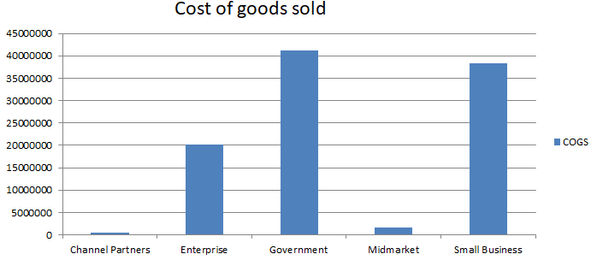
Graphical Analysis using Excel
Segment wise COGS , Cost of goods sold
Upon analysis of the data, it has been found that the Government sector has the highest COGS (Cost of Goods Sold) among all segments, while the Channel Partner segment has the lowest COGS

Slide 8
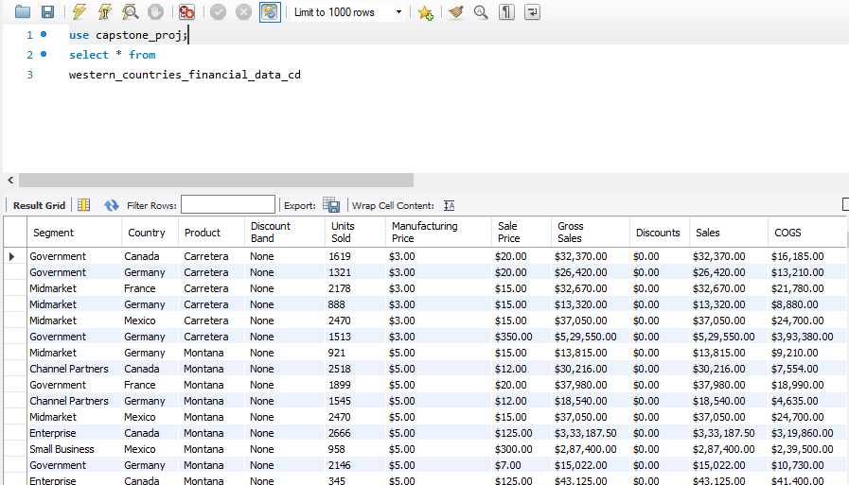
Insert the given data into the SQL server
Data is successfully inserted into a SQL DB.

Slide 9
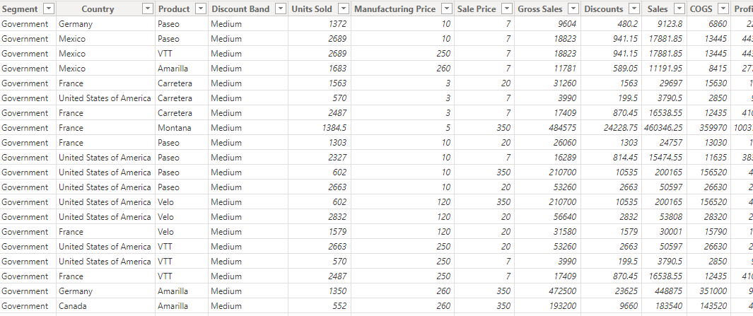
Import the Data from the SQL Database into PowerBI
Data is Successfully inserted into Power BI By SQL

Slide 10
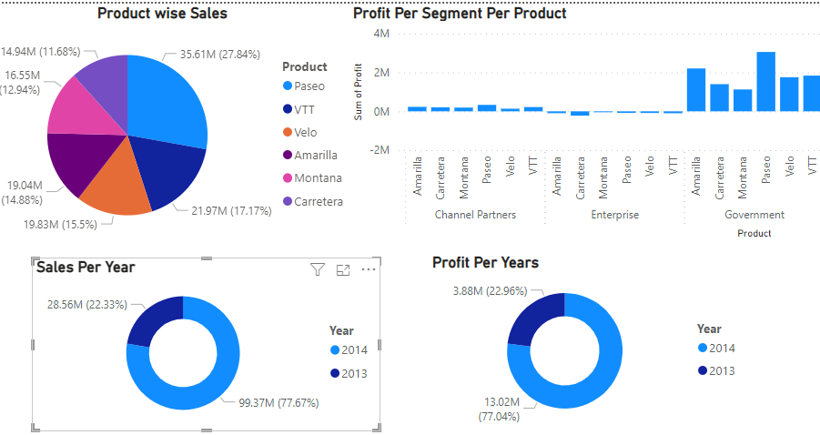
Interactive Dashboard by using visualization tools
Power BI Visualization

Slide 11
Conclusion and Inferences
Among the various segments, the Government sector has been found to generate the highest profit.
Within the Government sector, the product Paseo has been identified as the most profitable,
with a profit share of 26.85%. On the other hand, Montana has the lowest profit share at 9.89%.
The Small Business, Channel Partner, and Mid Market segments have also been found to be profitable,
with descending profit shares. Finally, the Enterprise segment has the lowest share of profit in the Government sector,
The year 2014, Saw the good amount of profit , sales and good amount of units sold

Slide 12
Endnotes
Reference Links:-
Links and Screenshots and files are attached separately in the ZIP

